Slide 1
Course Code: CSE 326
INTERNET PROGRAMMING LABORATORY
Notes:
‹#›

Slide 2
Course parameters
L- T- P : 0-0-2
Marks Weightage:
Attendance: 05
Continuous Assessment (CA): 45
End Term Practical : 50
# Note: MTT is not applicable for this course.

Slide 3
CA Component
PROJECT-WEBSITE DESIGN OFFLINE COMPULSORY
Allocation week:3 Submission week:11
Lab Evaluation OFFLINE BEST 1 OUT OF 2
Allocation week: 5 Submission week:6
CODE BASED TEST 1 OFFLINE BEST 1 OUT OF 2
Allocation week:11 Submission week:12

Slide 4
Books
Text Books:
HTML 5 COVERS CSS3, JAVASCRIPT,XML,XHTML,AJAX by KOGENT LEARNING, DREAMTECH PRESS
Reference Books:
WEB ENABLED COMMERCIAL APPLICATION DEVELOPMENT USING HTML,DHTML,JAVASCRIPT, DHTML AND PHP by IVAN BAYROSS, BPB PUBLICATIONS
2. BEGINNING HTML, XHTML, CSS AND JAVASCRIPT by JON DICKETT, WILEY

Slide 5
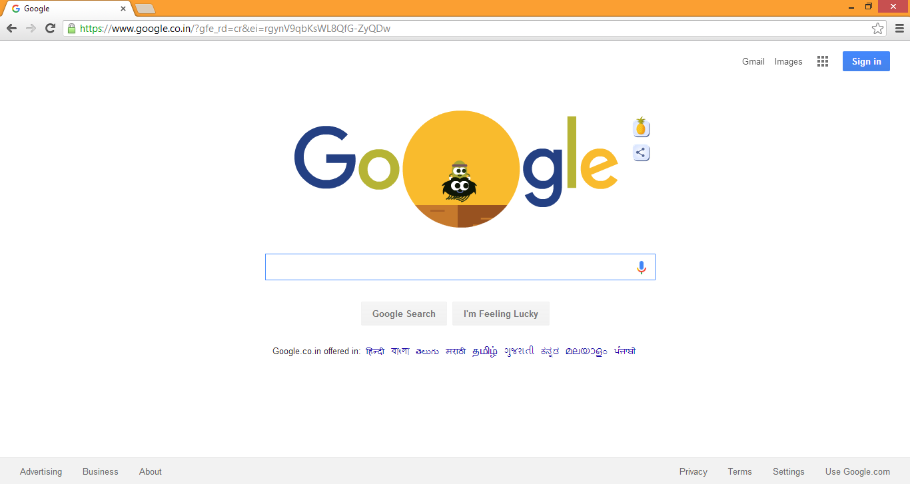

Slide 6
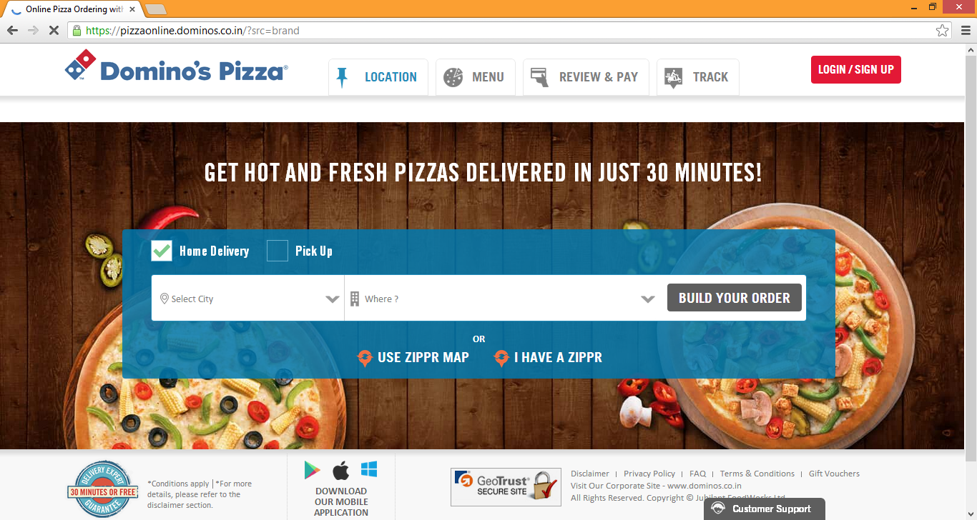

Slide 7
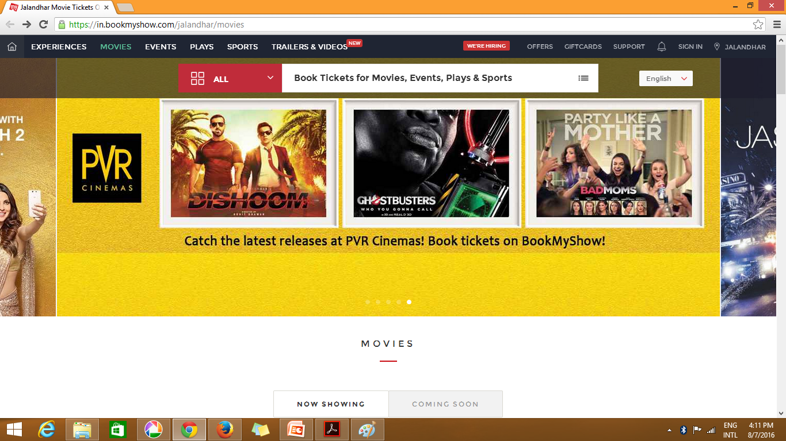

Slide 8
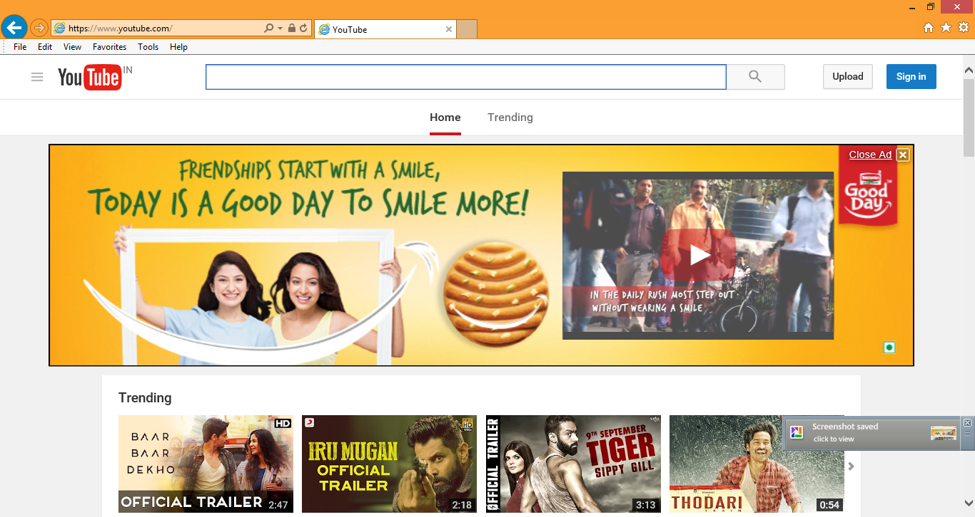

Slide 9


Slide 10
WEBSITE ?????
Website is a collection of related web pages, including multimedia content, typically identified with a common domain name, and published on at least one web server.
Notes:
‹#›

Slide 11

DOMAIN NAMES
Notes:
A domain name is an identification string that defines a realm of administrative autonomy, authority or control within the Internet. Domain names are formed by the rules and procedures of the Domain Name System (DNS). Any name registered in the DNS is a domain name.
‹#›

Slide 12
WEB SERVER
The primary function of a web server is to store, process and deliver web pages to clients.

Slide 13


Slide 14
What we will be studying
HTML 5
CSS
Java Script

Slide 15
COURSE OUTCOME
• Use current techniques, skills, and methods necessary for Web Designing.
• Design and implement responsive web pages with the help of CSS and Javascript.
• Create personal or business webpages following current industry standards using HTML5 technologies.
• Apply web programming principles to create an interactive website.

Slide 16
HTML
HTML stands for Hyper Text Markup Language, which is the most widely used language on Web to develop web pages.
HTML was created by Berners-Lee in late 1991 but "HTML 2.0" was the first standard HTML specification which was published in 1995. HTML 4.01 was a major version of HTML and it was published in late 1999. Though HTML 4.01 version is widely used but currently we are having HTML-5 version which is an extension to HTML 4.01, and this version was published in 2012.

Slide 17
HTML
Hypertext refers to the way in which Web pages (HTML documents) are linked together. Thus the link available on a webpage are called Hypertext.
As its name suggests, HTML is a Markup Language which means you use HTML to simply "mark up" a text document with tags that tell a Web browser how to structure it to display.

Slide 18
HTML 1.0 was the very first version of HTML. It consisted of only 18 elements with very limited functionalities.Since then, HTML has come a long way. There were many intermediate versions like HTML 2.0, HTML 3.2, HTML 4.01 and so on.HTML5 is one of the latest and most commonly used versions

Slide 19
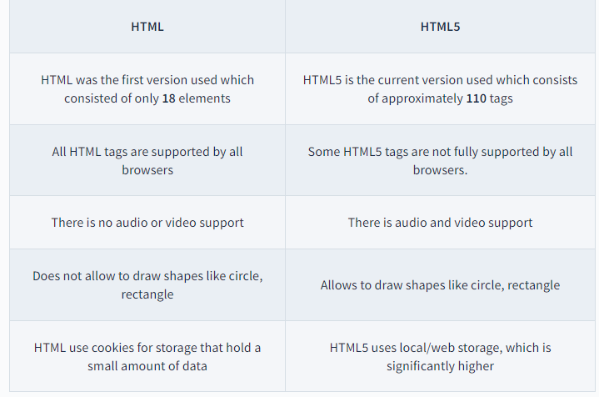
HTML VS HTML%

Slide 20
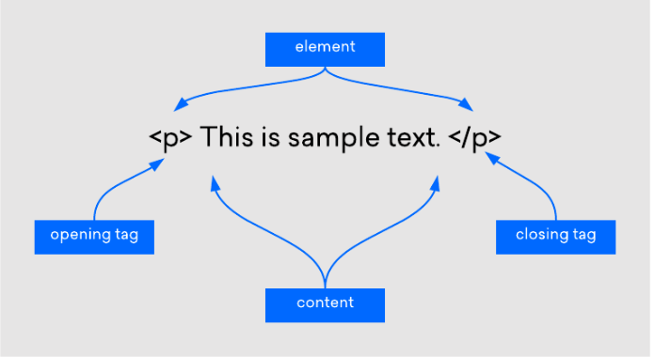
HTML element
An HTML element is a component of an HTML document that tells a web browser how to structure and interpret a part of the HTML document. HTML elements can contain formatting instructions, semantic meaning, and content.

Slide 21
An HTML element is defined by a starting tag. If the element contains other content, it ends with a closing tag, where the element name is preceded by a forward slash. So here <p>....</p> is an HTML element, <h1>...</h1> is another HTML element.

Slide 22
HTML Tag vs. Element
Technically, an HTML element is the collection of start tag, its attributes, an end tag and everything in between. On the other hand an HTML tag (either opening or closing) is used to mark the start or end of an element.Case Insensitivity in HTML Tags and Attributes
In HTML, tag and attribute names are not case-sensitive (but most attribute values are case-sensitive). It means the tag <P>, and the tag <p> defines the same thing in HTML which is a paragraph.

Slide 23
Nested HTML Elements
It is very much allowed to keep one HTML element inside another HTML element:
Example
<!DOCTYPE html>
<html>
<head> <title>Nested Elements Example</title> </head>
<body> <h1>This is <i>italic</i> heading</h1>
<p>This is <u>underlined</u> paragraph</p>
</body>
</html>

Slide 24
HTML Attributes
All HTML elements can have attributes
Attributes provide additional information about elements
Attributes are always specified in the start tag
Attributes usually come in name/value pairs like: name="value"

Slide 25
HTML document structure
<!DOCTYPE html> <html>
<head> <title>Page Title</title> </head> <body> <h1>My First Heading</h1> <p>My first paragraph.</p> </body> </html>

Slide 26
The <!DOCTYPE html> Tag
The <!DOCTYPE html> tag is the first tag of any HTML document. It's a special tag that does not have a closing set of brackets and doesn't have any HTML content inside it.
It is used only to tell the browser that the document loaded is an HTML document.

Slide 27
The <html> Tag
The first meaningful tag of any HTML document is the <html> tag. It indicates the scope of an HTML document. All the other tags and content that constitute your webpage go inside this <html> tag.
If you put an HTML tag outside the <html> tag, it may not b

Slide 28
The <head> Tag
The <head> tag appears at the top of any HTML document. It displays some other tags inside it that are used to give some additional information about the webpage.
For instance, it may have <meta> tag to provide some meta information about the document as shown below.

Slide 29
The <Meta> Tag
The <meta> tag defines metadata about an HTML document. Metadata is data (information) about data.
<meta> tags always go inside the <head> element, and are typically used to specify character set, page description, keywords, author of the document, and viewport settings.
Metadata will not be displayed on the page, but is machine parsable.
Metadata is used by browsers (how to display content or reload page), search engines (keywords), and other web services.

Slide 30
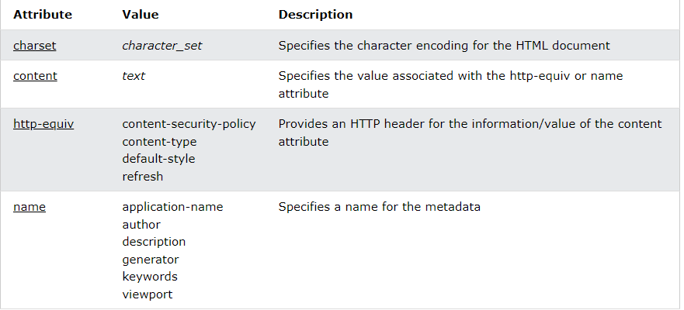
ATTRIBUTES OF META

Slide 31
<!DOCTYPE html>
<html>
<head>
<meta charset="UTF-8">
<meta name="description" content=“meta data code">
<meta name="keywords" content="HTML,CSS">
<meta name="author" content=“Isha">
<meta name="viewport" content="width=device-width, initial-scale=1.0">
</head>
<body>
<p>All meta information goes in the head section...</p>
</body>
</html>

Slide 32
The <title> Tag
The <title> tag is used to give a title to the HTML document. This title also appears on the tab of a browser where your HTML document is rendered.
The <body> Tag
The <body> tag encloses all HTML tags that are used to create your various HTML documents and webpages of your website. main content of your website is always present inside the <body> tag.
Notes:
‹#›

Slide 33
Unclosed HTML Tags
Some tags in HTML do not require a closing tag. They don't allow any content inside them.
Since these tags don't have a set of closing brackets, they're called as Unclosed HTML tags. They're also known as void elements in HTML.
For instance, the horizontal ruling tag <hr> is an unclosed HTML tag.

Slide 34
unclosed tags or void elements defined by HTML Standard:<area>
<base>
<br>
<col>
<embed>
<hr>
<img>
<input>
<keygen>
<link>
<menuitem>
<meta>
<param>
<source>
<track>

Slide 35
HTML Text Tags
Majority of content on any website comprises of texts. HTML provides a bunch of tags that allows us to render text on a webpage in different formats and sizes.
The <p> Tag
The <p> tag stands for the paragraph tag. It is used to render a paragraph or a group of words on the webpage.

Slide 36
The <span> Tag
The <span> tag is used for a group of words within a paragraph that need to be styled differently.
<p>
This is going to be a paragrahp.Amidst the paragraph is <span style="color:gray"> this sentence styled differently.</span> Rest of the paragraph is the same.</p>
<u> tag
The <u> tag is used to represent a non-literary explanation.By default, it underlines the text content
<u> this text will be underlined</u>

Slide 37
<meter> tag
The <meter> tag is used to define a scale with a given range and value.The tag requires a defined value with min value and max value of the scale. The min, max, and value are attributes of the tag.
You can also give low and high values to the scale which is used to change the color of the scale. If the value of the scale is below the low value then the scale is green, if the value is between low and high then the scale is yellow and if the scale is above the high value then the scale is red.

Slide 38
Use the Meter Element to Measure Data within a Given Range
<!DOCTYPE html> <html> <head> </head> <body> <meter value="4" min="0" max="10">4 out of 10</meter> 4 Out of 10<br> </body> </html>
or<!DOCTYPE html> for accessibility purposes we have to use the <label></label> tag which labels the <meter></meter> tags and let the browser know about the measurement of data.
<body>
<label for="disk_d">Disk usage D:</label>
<meter id="disk_d" value="0.65">65%</meter>
</body>

Slide 39
High and low range
<!DOCTYPE html>
<html>
<head>
</head>
<body>
<meter value="2" min="0" max="10" low="3">2 out of 10</meter> 2 Out of 10<br>
<meter value="9" min="0" max="10" high="8">9 out of 10</meter> 9 Out of 10
</body>
</html>

Slide 40
The Heading Tags
In a blogging website,you may need a title to display the blog title that has a large font-size. Or you may need to display titles of individual sections of the blog in a smaller font-size.
Thus, there are numerous such cases where you need to use headings. HTML has 6 different heading tags that you can use to render headings of different sizes.
The <h1> is the largest heading, followed by <h2>, then <h3> till <h6> which is the smallest heading

Slide 41
Heading Tags
Any document starts with a heading. You can use different sizes for your headings. HTML also has six levels of headings, which use the elements <h1>, <h2>, <h3>, <h4>, <h5>, and <h6>. While displaying any heading, browser adds one line before and one line after that heading.

Slide 42
Example
<!DOCTYPE html>
<html>
<head>
<title> Heading Example</title>
</head>
<body>
<h1>This is heading 1</h1>
<h2>This is heading 2</h2>
<h3>This is heading 3</h3>
<h4>This is heading 4</h4>
<h5>This is heading 5</h5>
<h6>This is heading 6</h6>
</body>
</html>

Slide 43
<h1> This is H1 </h1>
<h2> This is H2 </h2>
<h3> This is H3 </h3>
<h4> This is H4 </h4>
<h5> This is H5 </h5>
<h6> This is H6 </h6>

Slide 44
Paragraph Tag
The <p> tag offers a way to structure your text into different paragraphs. Each paragraph of text should go in between an opening <p> and a closing </p> tag

Slide 45
Example
<!DOCTYPE html>
<html>
<head>
<title>Paragraph Example</title>
</head>
<body>
<p>Here is a first paragraph of text.</p>
<p>Here is a second paragraph of text.</p>
<p>Here is a third paragraph of text.</p>
</body>
</html>

Slide 46
Line Break Tag
Whenever you use the <br /> element, anything following it starts from the next line. This tag is an example of an empty element, where you do not need opening and closing tags, as there is nothing to go in between them.
The <br /> tag has a space between the characters br and the forward slash. If you omit this space, older browsers will have trouble rendering the line break, while if you miss the forward slash character and just use <br> it is not valid in XHTML

Slide 47
Example
<!DOCTYPE html>
<html>
<head>
<title>Line Break Example</title>
</head>
<body>
<p>Hello<br />
You delivered your assignment ontime.<br />
Thanks<br />
Isha </p>
</body>
</html>

Slide 48
Centering Content
You can use <center> tag to put any content in the center of the page or any table cell.

Slide 49
Example
<!DOCTYPE html>
<html>
<head>
<title>Centring Content Example</title>
</head>
<body>
<p>This text is not in the center.</p>
<center> <p>This text is in the center.</p> </center>
</body>
</html>

Slide 50
Horizontal Rules
Horizontal lines are used to visually break up sections of a document. The <hr> tag creates a line from the current position in the document to the right margin and breaks the line accordingly.

Slide 51
Example
<!DOCTYPE html>
<html>
<head>
<title>Horizontal Line Example</title>
</head>
<body>
<p>This is paragraph one and should be on top</p>
<hr \>
<p>This is paragraph two and should be at bottom</p>
</body>
</html>

Slide 52
Preserve Formatting
Sometimes you want your text to follow the exact format of how it is written in the HTML document. In those cases, you can use the preformatted tag <pre>.

Slide 53
Example
<!DOCTYPE html>
<html>
<head>
<title>Preserve Formatting Example</title>
</head>
<body>
<pre>
function newFunction ( Text )
{
alert (Text)
}
</pre>
</body>
</html>

Slide 54
HTML Comments
Comment is a piece of code which is ignored by any web browser. It is a good practice to add comments into your HTML code, especially in complex documents, to indicate sections of a document, and any other notes to anyone looking at the code. Comments help you and others understand your code and increases code readability.
HTML comments are placed in between <!-- ... --> tags. So any content placed with-in <!-- ... --> tags will be treated as comment and will be completely ignored by the browser.

Slide 55
Example
<!DOCTYPE html>
<html>
<head> <!-- Document Header Starts -->
<title>This is document title</title>
</head> <!-- Document Header Ends -->
<body>
<p>Document content goes here.....</p>
</body>
</html>

Slide 56
Valid vs Invalid Comments
Comments do not nest which means a comment can not be put inside another comment. Second the double-dash sequence "--" may not appear inside a comment except as part of the closing --> tag. You must also make sure that there are no spaces in the start-of-comment string.

Slide 57
Multiline Comments
So far we have seen single line comments, but HTML supports multi-line comments as well.
You can comment multiple lines by the special beginning tag <!-- and ending tag --> placed before the first line and end of the last line as shown in the given example below.

Slide 58
Example
<!DOCTYPE html>
<html>
<head>
<title>Multiline Comments</title>
</head>
<body>
<!-- This is a multiline comment and
it can span through as many as
lines you like. -->
<p>Document content goes here.....</p>
</body>
</html>

Slide 59
Using Comment Tag
There are few browsers that support <comment> tag to comment a part of HTML code.
Example
<!DOCTYPE html>
<html>
<head>
<title>Using Comment Tag</title>
</head>
<body>
<p>This is <comment>not</comment> Internet Explorer.</p>
</body>
</html>

Slide 60
HTML Quotation
The HTML <q> element defines a short quotation.
Browsers usually insert quotation marks around the <q> element.
<p>goal of life should be to: <q>Build a future where people live in harmony with nature.</q></p>

Slide 61
HTML <cite> for Work Title
HTML <cite> tag specifies a citation, it provides reference or title to a creative work, quoted content, books, websites, a research paper, a blog-spot, painting, etc.
The main purpose of adding <cite> element is to provide or identify the source of the quote or any content.the content written between <cite> tag renders in the italic form on the browser, and it can be overridden using CSS in your HTML document.

Slide 62
The cite attribute can be used on the following elements:
Blockquote
Del
Ins
q

Slide 63
<!DOCTYPE html>
<html>
<head>
<title>HTML cite Tag</title>
</head>
<body>
<p>The learning content can be referred from <cite>Simplilearn</cite><p>
</body>
</html>

Slide 64
Example
<html>
<body><cite><a href="http://www.george-orwell.org/1984/0.html">
Nineteen Eighty-Four</a></cite> by George Orwell (Part 1, Chapter 1).
</body>
</html>

Slide 65
TYPES OF TAGS IN HTML
Basic HTML
Formatting
Forms and Input
Frames
Images
Audio / Video
Links
Lists
Tables
Styles and Semantics
Meta Info
Programming
Notes:
‹#›

Slide 66
Basic HTML
Tag | Description
<!DOCTYPE> | Defines the document type
<html> | Defines an HTML document
<title> | Defines a title for the document
<body> | Defines the document's body
<h1> to <h6> | Defines HTML headings
<p> | Defines a paragraph
<br> | Inserts a single line break
<hr> | Defines a thematic change in the content
<!--...--> | Defines a comment

Slide 67
Formatting
Tag | Description
<abbr> | Defines an abbreviation or an acronym
<address> | Defines contact information for the author/owner of a document/article
<b> | Defines bold text
<bdi> | Isolates a part of text that might be formatted in a different direction from other text outside it
<bdo> | Overrides the current text direction

Slide 68
Forms and Input
Tag | Description
<form> | Defines an HTML form for user input
<input> | Defines an input control
<textarea> | Defines a multiline input control (text area)
<button> | Defines a clickable button
<select> | Defines a drop-down list
<optgroup> | Defines a group of related options in a drop-down list
<option> | Defines an option in a drop-down list
<label> | Defines a label for an <input> element
<fieldset> | Groups related elements in a form
<legend> | Defines a caption for a <fieldset> element
<datalist> | Specifies a list of pre-defined options for input controls
<keygen> | Defines a key-pair generator field (for forms)
<output> | Defines the result of a calculation

Slide 69
Frames
Tag | Description
<iframe> | Defines an inline frame

Slide 70
Images
Tag | Description
<img> | Defines an image
<map> | Defines a client-side image-map
<area> | Defines an area inside an image-map
<canvas> | Used to draw graphics, on the fly, via scripting (usually JavaScript)
<figcaption> | Defines a caption for a <figure> element
<figure> | Specifies self-contained content

Slide 71
Audio / Video
Tag | Description
<audio> | Defines sound content
<source> | Defines multiple media resources for media elements (<video> and <audio>)
<track> | Defines text tracks for media elements (<video> and <audio>)
<video> | Defines a video or movie

Slide 72
Links
Tag | Description
<a> | Defines a hyperlink
<link> | Defines the relationship between a document and an external resource (most used to link to style sheets)
<nav> | Defines navigation links

Slide 73
Lists
Tag | Description
<ul> | Defines an unordered list
<ol> | Defines an ordered list
<li> | Defines a list item
<dl> | Defines a description list
<dt> | Defines a term/name in a description list
<dd> | Defines a description of a term/name in a description list
<menu> | Defines a list/menu of commands
<menuitem> | Defines a command/menu item that the user can invoke from a popup menu

Slide 74
Tables
Tag | Description
<table> | Defines a table
<caption> | Defines a table caption
<th> | Defines a header cell in a table
<tr> | Defines a row in a table
<td> | Defines a cell in a table
<thead> | Groups the header content in a table
<tbody> | Groups the body content in a table
<tfoot> | Groups the footer content in a table
<col> | Specifies column properties for each column within a <colgroup> element
<colgroup> | Specifies a group of one or more columns in a table for formatting

Slide 75
Styles and Semantics
Tag | Description
<style> | Defines style information for a document
<div> | Defines a section in a document
<span> | Defines a section in a document
<header> | Defines a header for a document or section
<footer> | Defines a footer for a document or section
<main> | Specifies the main content of a document
<section> | Defines a section in a document
<article> | Defines an article
<aside> | Defines content aside from the page content
<details> | Defines additional details that the user can view or hide
<dialog> | Defines a dialog box or window
<summary> | Defines a visible heading for a <details> element

Slide 76
Meta Info
Tag | Description
<head> | Defines information about the document
<meta> | Defines metadata about an HTML document

Slide 77
Programming
Tag | Description
<script> | Defines a client-side script
<noscript> | Defines an alternate content for users that do not support client-side scripts
<embed> | Defines a container for an external (non-HTML) application
<object> | Defines an embedded object
<param> | Defines a parameter for an object

